Slide 1
Digital Image Processing
Colour Image Processing

Slide 2
Introduction
Today we’ll look at colour image processing, covering:
  Colour fundamentals
  Colour models

Slide 3
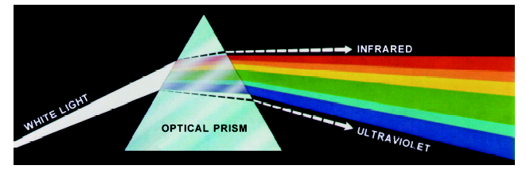

Colour Fundamentals
In 1666 Sir Isaac Newton discovered that when a beam of sunlight passes through a glass prism, the emerging beam is split into a spectrum of colours
Images taken from Gonzalez & Woods, Digital Image Processing (2002)

Slide 4

Colour Fundamentals (cont…)
The colours that humans and most animals perceive in an object are determined by the nature of the light reflected from the object
For example, green
objects reflect light
with wave lengths
primarily in the range
of 500 – 570 nm while
absorbing most of the
energy at other
wavelengths
White Light
Colours Absorbed
Green Light

Slide 5
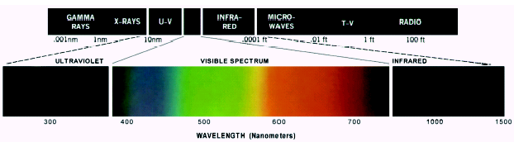
Colour Fundamentals (cont…)
Chromatic light spans the electromagnetic spectrum from approximately 400 to 700 nm
As we mentioned before human colour vision is achieved through 6 to 7 million cones in each eye
Images taken from Gonzalez & Woods, Digital Image Processing (2002)

Slide 6
Colour Fundamentals (cont…)
Approximately 66% of these cones are sensitive to red light, 33% to green light and 6% to blue light
Absorption curves for the different cones have been determined experimentally
Strangely these do not match the CIE standards for red (700nm), green (546.1nm) and blue (435.8nm) light as the standards were developed before the experiments!

Slide 7
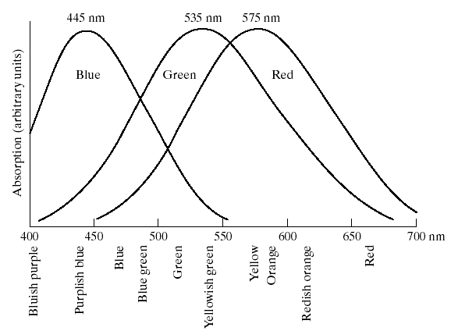
Colour Fundamentals (cont…)
Images taken from Gonzalez & Woods, Digital Image Processing (2002)

Slide 8
Colour Fundamentals (cont…)
3 basic qualities are used to describe the quality of a chromatic light source:
  Radiance: the total amount of energy that flows from the light source (measured in watts)
  Luminance: the amount of energy an observer perceives from the light source (measured in lumens)
    Note we can have high radiance, but low luminance
  Brightness: a subjective (practically unmeasurable) notion that embodies the intensity of light
We’ll return to these later on

Slide 9
CIE Chromacity Diagram
Specifying colours systematically can be achieved using the CIE chromacity diagram
On this diagram the x-axis represents the proportion of red and the y-axis represents the proportion of green used
The proportion of blue used in a colour is calculated as:
z = 1 – (x + y)

Slide 10
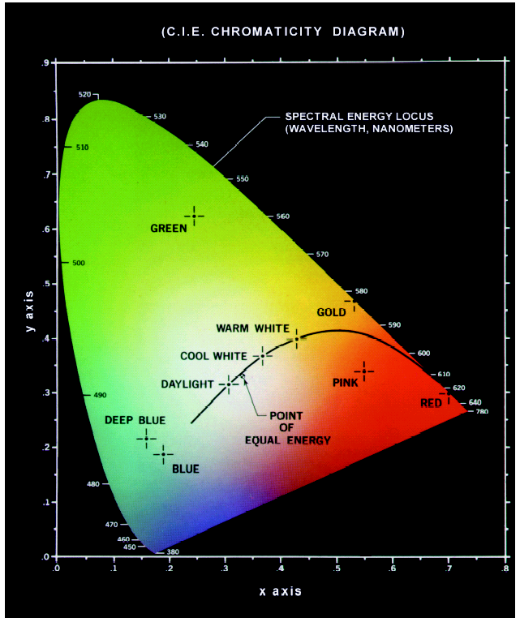
CIE Chromacity Diagram (cont…)
Green: 62% green, 25% red and 13% blue
Red: 32% green, 67% red and 1% blue
Images taken from Gonzalez & Woods, Digital Image Processing (2002)

Slide 11
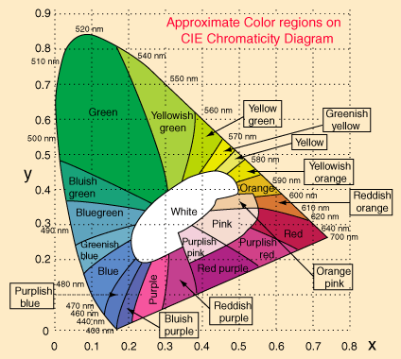

Slide 12
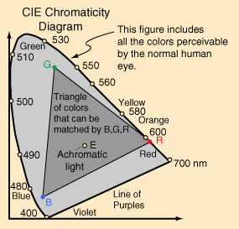


Slide 13
CIE Chromacity Diagram (cont…)
Any colour located on the boundary of the chromacity chart is fully saturated
The point of equal energy has equal amounts of each colour and is the CIE standard for pure white
Any straight line joining two points in the diagram defines all of the different colours that can be obtained by combining these two colours additively
This can be easily extended to three points

Slide 14
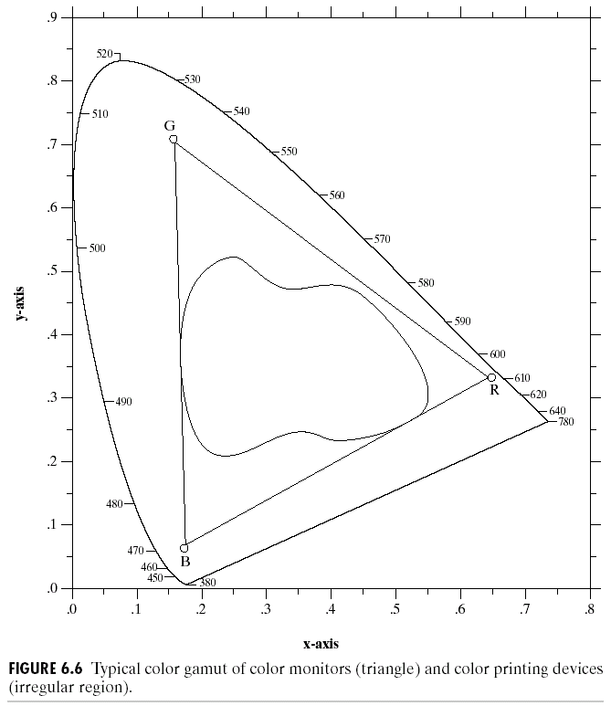
CIE Chromacity Diagram (cont…)
This means the entire colour range cannot be displayed based on any three colours
The triangle shows the typical colour gamut produced by RGB monitors
The strange shape is the gamut achieved by high quality colour printers
Images taken from Gonzalez & Woods, Digital Image Processing (2002)

Slide 15
Colour Models
From the previous discussion it should be obvious that there are different ways to model colour
We will consider two very popular models used in colour image processing:
  RGB (Red Green Blue)
  HIS (Hue Saturation Intensity)

Slide 16
RGB
In the RGB model each colour appears in its primary spectral components of red, green and blue
The model is based on a Cartesian coordinate system
  RGB values are at 3 corners
  Cyan magenta and yellow are at three other corners
  Black is at the origin
  White is the corner furthest from the origin
  Different colours are points on or inside the cube represented by RGB vectors

Slide 17
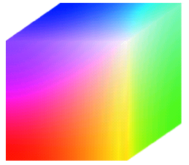
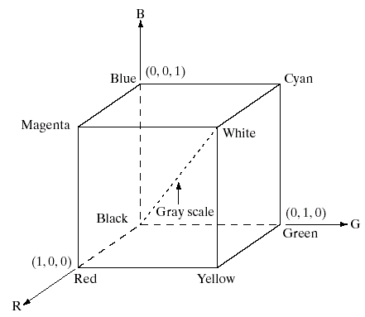
RGB (cont…)
Images taken from Gonzalez & Woods, Digital Image Processing (2002)

Slide 18
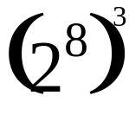
RGB (cont…)
Images represented in the RGB colour model consist of three component images – one for each primary colour
When fed into a monitor these images are combined to create a composite colour image
The number of bits used to represent each pixel is referred to as the colour depth
A 24-bit image is often referred to as a full-colour image as it allows = 16,777,216 colours

Slide 19
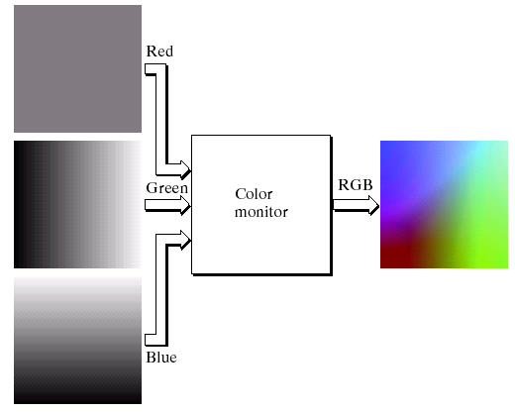
RGB (cont…)
Images taken from Gonzalez & Woods, Digital Image Processing (2002)

Slide 20
The HSI Colour Model
RGB is useful for hardware implementations and is serendipitously related to the way in which the human visual system works
However, RGB is not a particularly intuitive way in which to describe colours
Rather when people describe colours they tend to use hue, saturation and brightness
RGB is great for colour generation, but HSI is great for colour description

Slide 21
The HSI Colour Model (cont…)
The HSI model uses three measures to describe colours:
  Hue: A colour attribute that describes a pure colour (pure yellow, orange or red)
  Saturation: Gives a measure of how much a pure colour is diluted with white light
  Intensity: Brightness is nearly impossible to measure because it is so subjective. Instead we use intensity. Intensity is the same achromatic notion that we have seen in grey level images

Slide 22
HSI, Intensity & RGB
Intensity can be extracted from RGB images – which is not surprising if we stop to think about it
Remember the diagonal on the RGB colour cube that we saw previously ran from black to white
Now consider if we stand this cube on the black vertex and position the white vertex directly above it

Slide 23
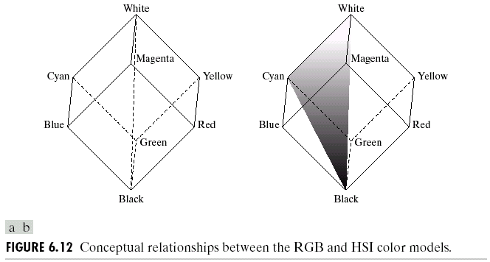
HSI, Intensity & RGB (cont…)
Now the intensity component
of any colour can be
determined by passing a
plane perpendicular to
the intenisty axis and
containing the colour
point
The intersection of the plane
with the intensity axis gives us the intensity component of the colour
Images taken from Gonzalez & Woods, Digital Image Processing (2002)

Slide 24
HSI, Hue & RGB
In a similar way we can extract the hue from the RGB colour cube
Consider a plane defined by
the three points cyan, black
and white
All points contained in
this plane must have the
same hue (cyan) as black
and white cannot contribute
hue information to a colour
Images taken from Gonzalez & Woods, Digital Image Processing (2002)

Slide 25
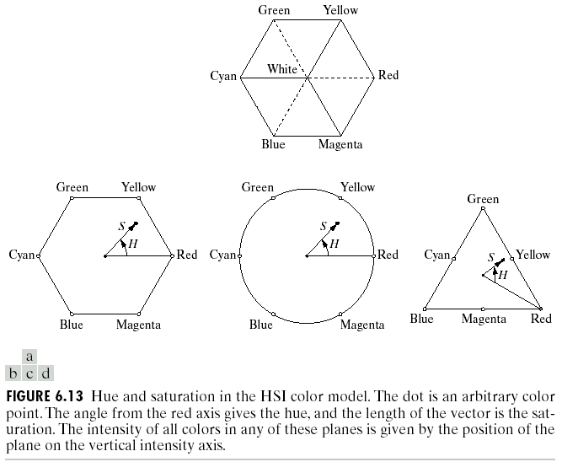
The HSI Colour Model
Consider if we look straight down at the RGB cube as it was arranged previously
We would see a hexagonal
shape with each primary
colour separated by 120°
and secondary colours
at 60° from the primaries
So the HSI model is
composed of a vertical
intensity axis and the locus of colour points that lie on planes perpendicular to that axis
Images taken from Gonzalez & Woods, Digital Image Processing (2002)

Slide 26
The HSI Colour Model (cont…)
To the right we see a hexagonal
shape and an arbitrary colour
point
  The hue is determined by an
  angle from a reference point,
  usually red
  The saturation is the distance from the origin to the point
  The intensity is determined by how far up the vertical intenisty axis this hexagonal plane sits (not apparent from this diagram
Images taken from Gonzalez & Woods, Digital Image Processing (2002)

Slide 27
The HSI Colour Model (cont…)
Because the only important things are the angle and the length of the saturation vector this plane is also often represented as a circle or a triangle
Images taken from Gonzalez & Woods, Digital Image Processing (2002)

Slide 28
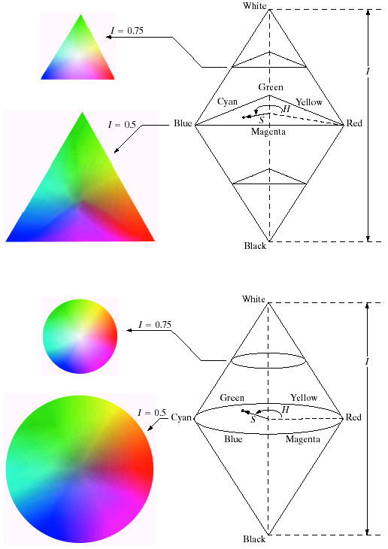
HSI Model Examples
Images taken from Gonzalez & Woods, Digital Image Processing (2002)

Slide 29
HSI Model Examples
Images taken from Gonzalez & Woods, Digital Image Processing (2002)

Slide 30
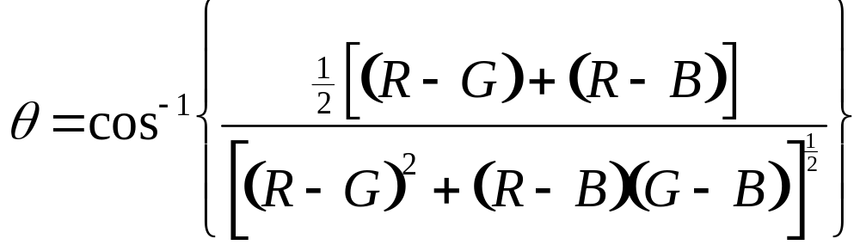
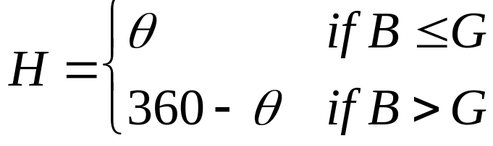
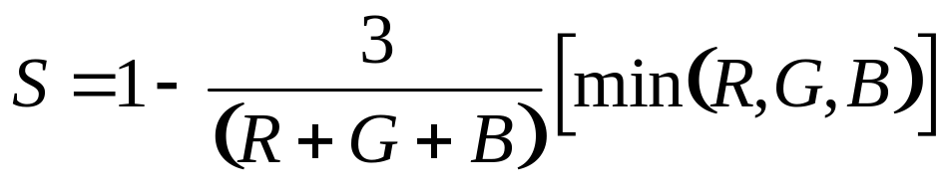

Converting From RGB To HSI
Given a colour as R, G, and B its H, S, and I values are calculated as follows:

Slide 31
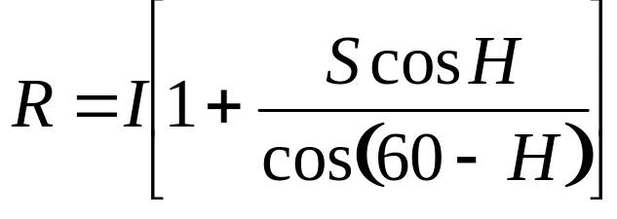


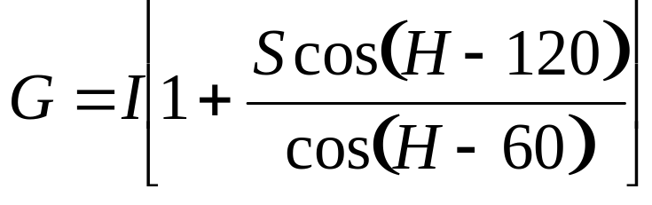


Converting From HSI To RGB
Given a colour as H, S, and I it’s R, G, and B values are calculated as follows:
  RG sector (0 <= H < 120°)
  GB sector (120° <= H < 240°)

Slide 32
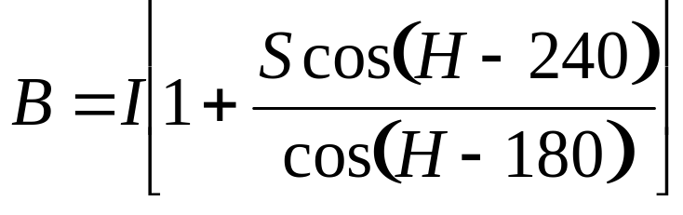


Converting From HSI To RGB (cont…)
  BR sector (240° <= H <= 360°)

Slide 33
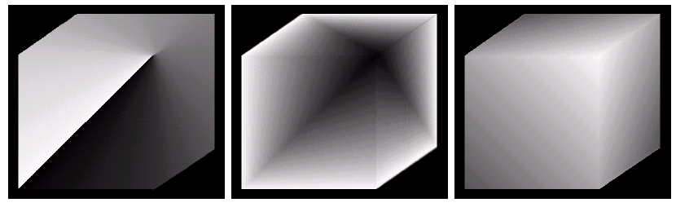
HSI & RGB
RGB Colour Cube
Images taken from Gonzalez & Woods, Digital Image Processing (2002)
H, S, and I Components of RGB Colour Cube

Slide 34
Manipulating Images In The HSI Model
In order to manipulate an image under the HIS model we:
  First convert it from RGB to HIS
  Perform our manipulations under HSI
  Finally convert the image back from HSI to RGB
RGB Image
HSI Image
RGB Image
Manipulations

Slide 35
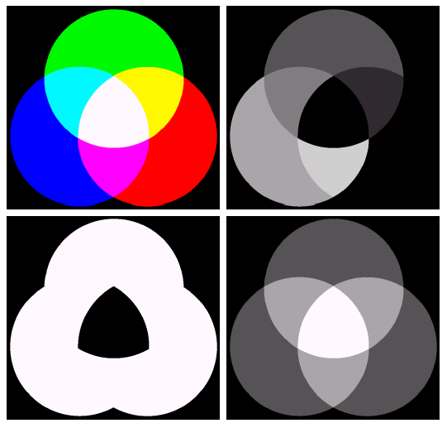
RGB -> HSI -> RGB
RGB Image
Hue
Images taken from Gonzalez & Woods, Digital Image Processing (2002)
Saturation
Intensity

Slide 36
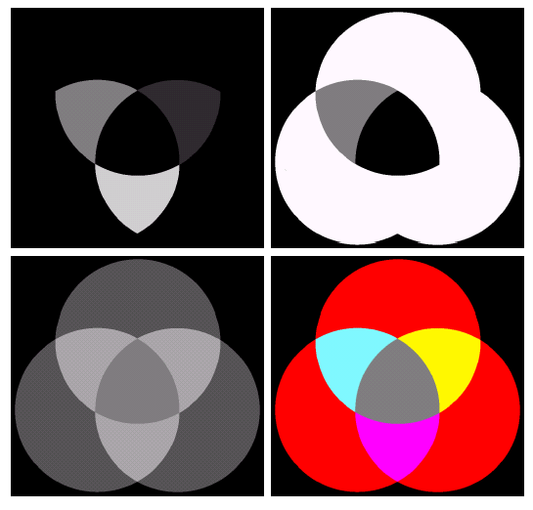
RGB -> HSI -> RGB (cont…)
Hue
Saturation
Images taken from Gonzalez & Woods, Digital Image Processing (2002)
Intensity
RGB Image

Slide 37
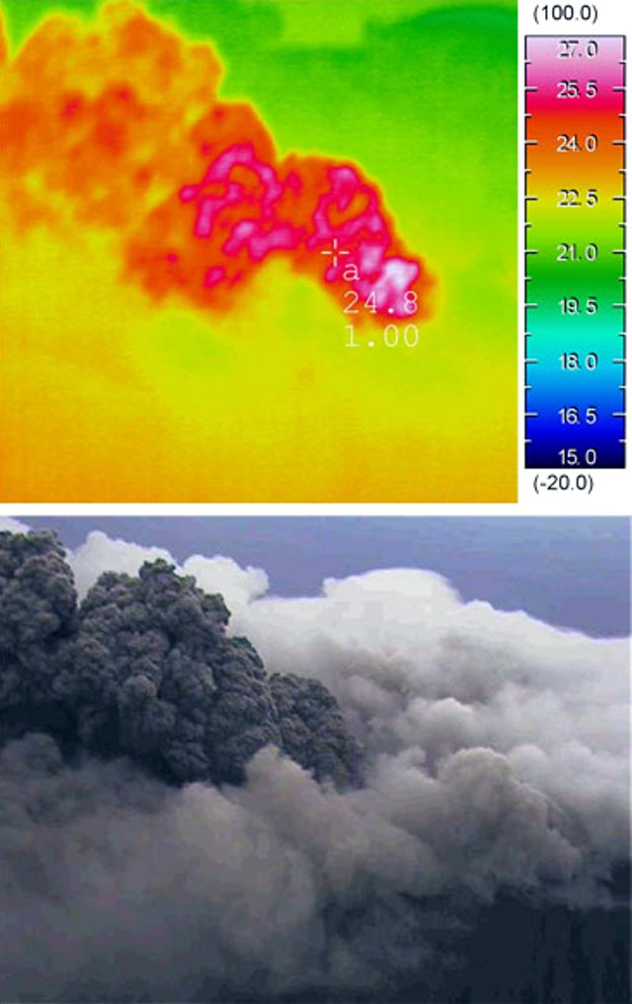
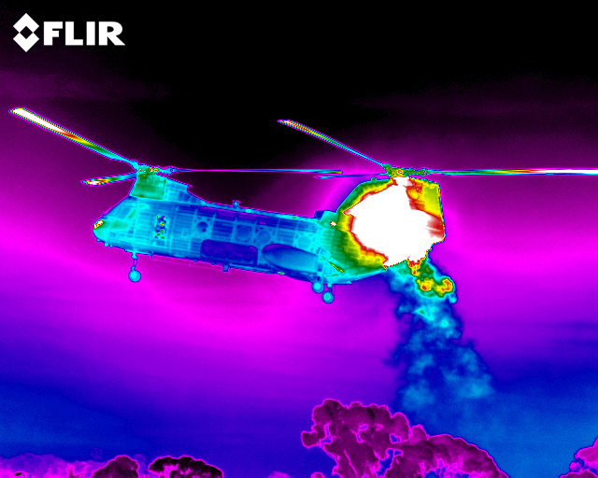
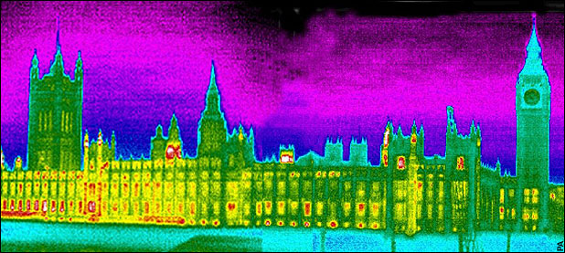
Pseudocolour Image Processing
Pseudocolour (also called false colour) image processing consists of assigning colours to grey values based on a specific criterion
The principle use of pseudocolour image processing is for human visualisation
  Humans can discern between thousands of colour shades and intensities, compared to only about two dozen or so shades of grey

Slide 38
Pseudo Colour Image Processing – Intensity Slicing
Intensity slicing and colour coding is one of the simplest kinds of pseudocolour image processing
First we consider an image as a 3D function mapping spatial coordinates to intensities (that we can consider heights)
Now consider placing planes at certain levels parallel to the coordinate plane
If a value is one side of such a plane it is rendered in one colour, and a different colour if on the other side

Slide 39
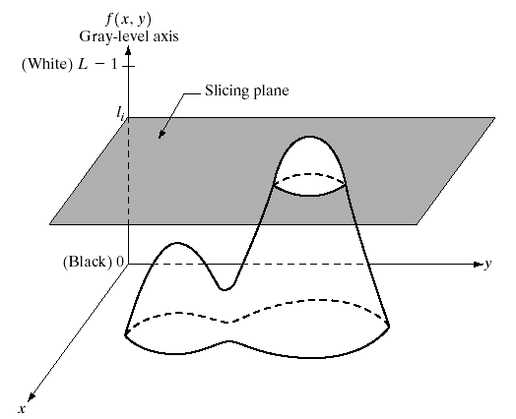
Pseudocolour Image Processing – Intensity Slicing (cont…)
Images taken from Gonzalez & Woods, Digital Image Processing (2002)

Slide 40
Pseudocolour Image Processing – Intensity Slicing (cont…)
In general intensity slicing can be summarised as:
  Let [0, L-1] represent the grey scale
  Let l₀ represent black [f(x, y) = 0] and let l_{L-1} represent white [f(x, y) = L-1]
  Suppose P planes perpendicular to the intensity axis are defined at levels l_{1,} l_{2, …,} l_{p}
  Assuming that 0 < P < L-1 then the P planes partition the grey scale into P + 1 intervals V₁, V₂,…,V_{P+1}

Slide 41
Pseudocolour Image Processing – Intensity Slicing (cont…)
  Grey level colour assignments can then be made according to the relation:
  where ck is the colour associated with the k^{th} intensity level V_{k} defined by the partitioning planes at l = k – 1 and l = k

Slide 42
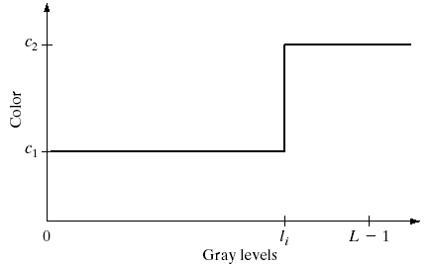
RGB -> HSI -> RGB (cont…)
Images taken from Gonzalez & Woods, Digital Image Processing (2002)

Slide 43
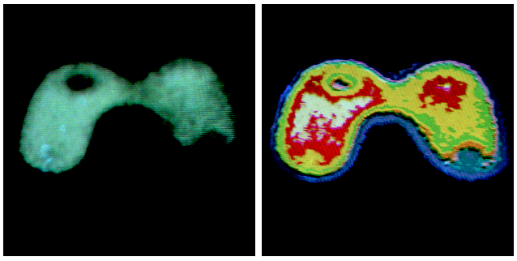
RGB -> HSI -> RGB (cont…)
Images taken from Gonzalez & Woods, Digital Image Processing (2002)

Slide 44
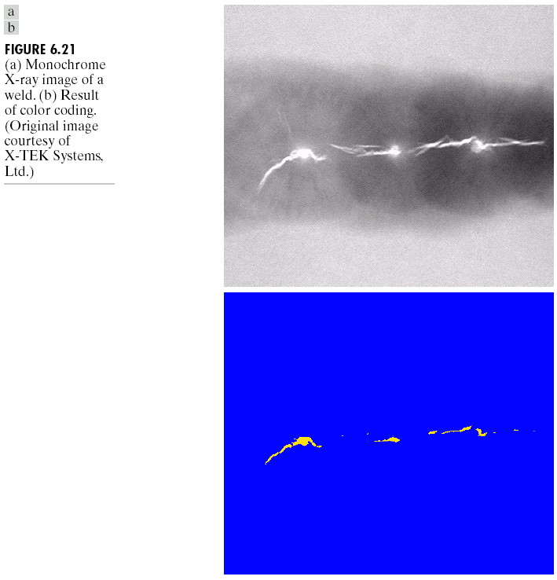
RGB -> HSI -> RGB (cont…)
Images taken from Gonzalez & Woods, Digital Image Processing (2002)

Slide 45
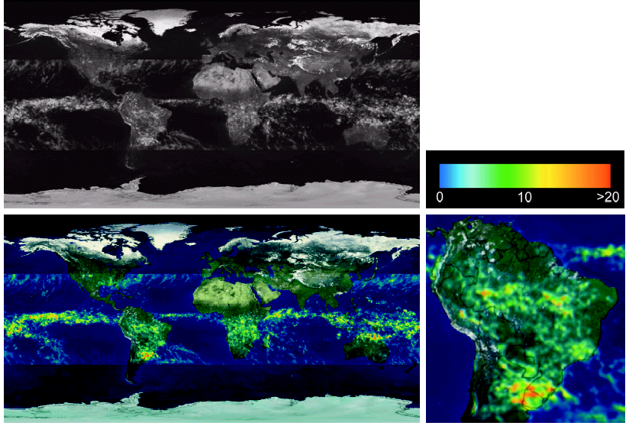
RGB -> HSI -> RGB (cont…)
Images taken from Gonzalez & Woods, Digital Image Processing (2002)

